Slide 1
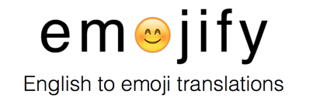

Slide 2




Chenhui Zhou
Computer Engineering
McCormick
Master’s
Colin Mo
Journalism
Medill
Master’s
Dara Rubin
Journalism
Medill ‘17
Bachelor’s
Diane Liu
Computer Science
McCormick ‘17
BS/MS

Slide 3
What is emojify and who is it for?
Allows users to take English words or phrases and translate them into the emoji equivalent
For use by a social media campaign manager to attract millennials, the trendy editor who wishes to attract a different kind of article viewership, or the bored office worker seeking a few minutes of entertainment
Notes:
Colin

Slide 4
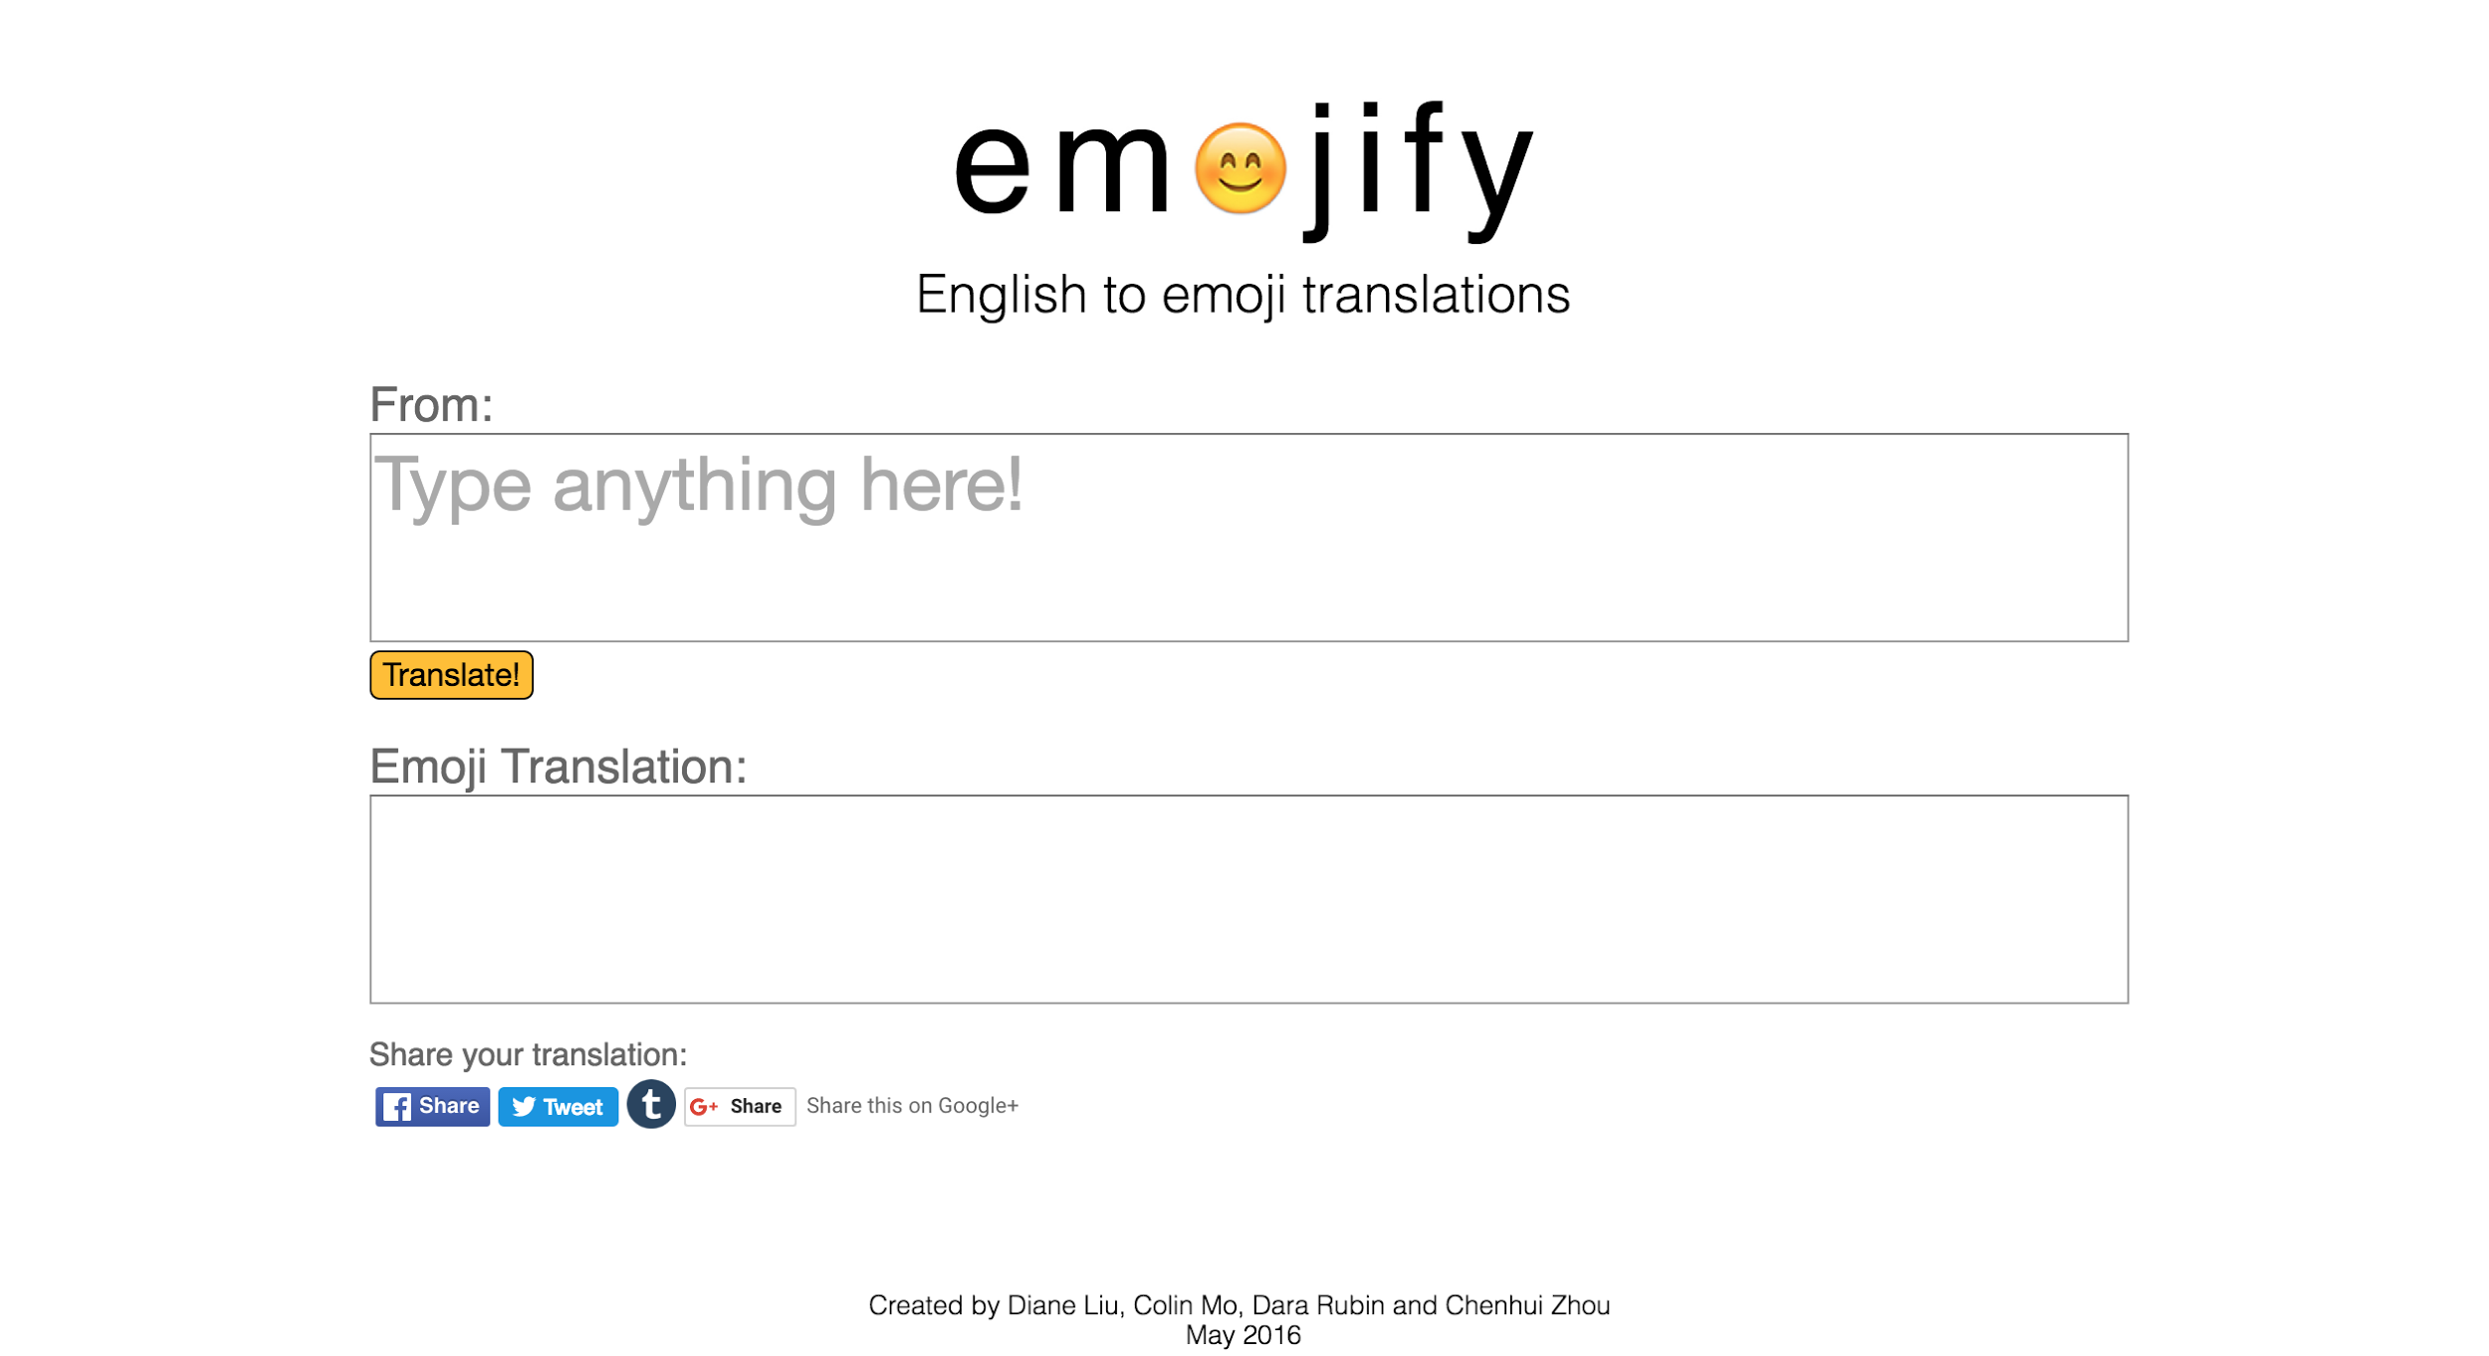
emojifyapp.herokuapp.com
Notes:
Dara

Slide 5
Architecture: How it works
NLTK, Wordnet
Tokenize, trim, lemmatize input
User input
Emojify website
HTML, CSS, JS
Flask server
Python
Bigram, unigram lookup
Synonym
lookup
Display
output
Return result
Emoji Dictionary
JSON
Notes:
Roger

Slide 6
Key Challenges
How to go from a human interpretation of a phrase into more of a computational process that still makes sense to the user
The existing dictionary we used required a lot of editing and manual inputs
Words entered into the translator did not always exist in our dictionary
Used WordNet to find synonyms
The back end separated “New York” into “New” and “York” providing incorrect emoji translations
Searching for words in groups of two first, then single
Notes:
Roger

Slide 7
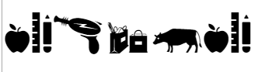
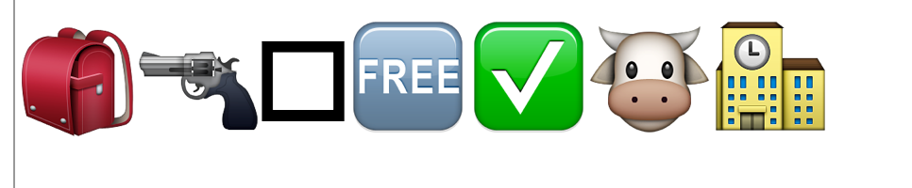
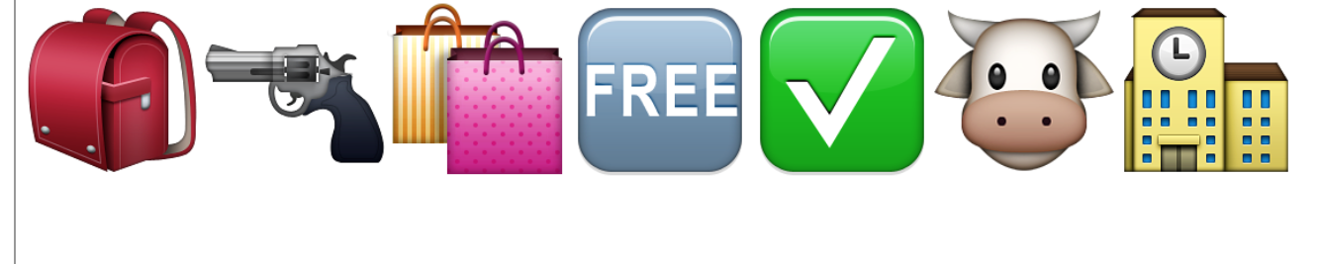
What’s next
Have an expanded emoji library to utilize more translations in the future
Consider the impact of Macs and non-Apple computers getting different icons corresponding to the same emoji, as well as emojis not showing up when the OS has not been updated
Example: Virginia student charged with stealing 'free' milk from school
Colin’s PC
Dara’s not updated Apple OSX
Chenhui’s updated Apple OSX
Notes:
Colin

